Slide 1

RNS Institute Of Technology
Channasandra, Dr. Vishnuvardan Road Bengaluru-560 098
Department of Information science
SALES ANALYSIS
Under Guidenance Of – Akshay Chaskar
Presented By – Jyoti Verma

Slide 2
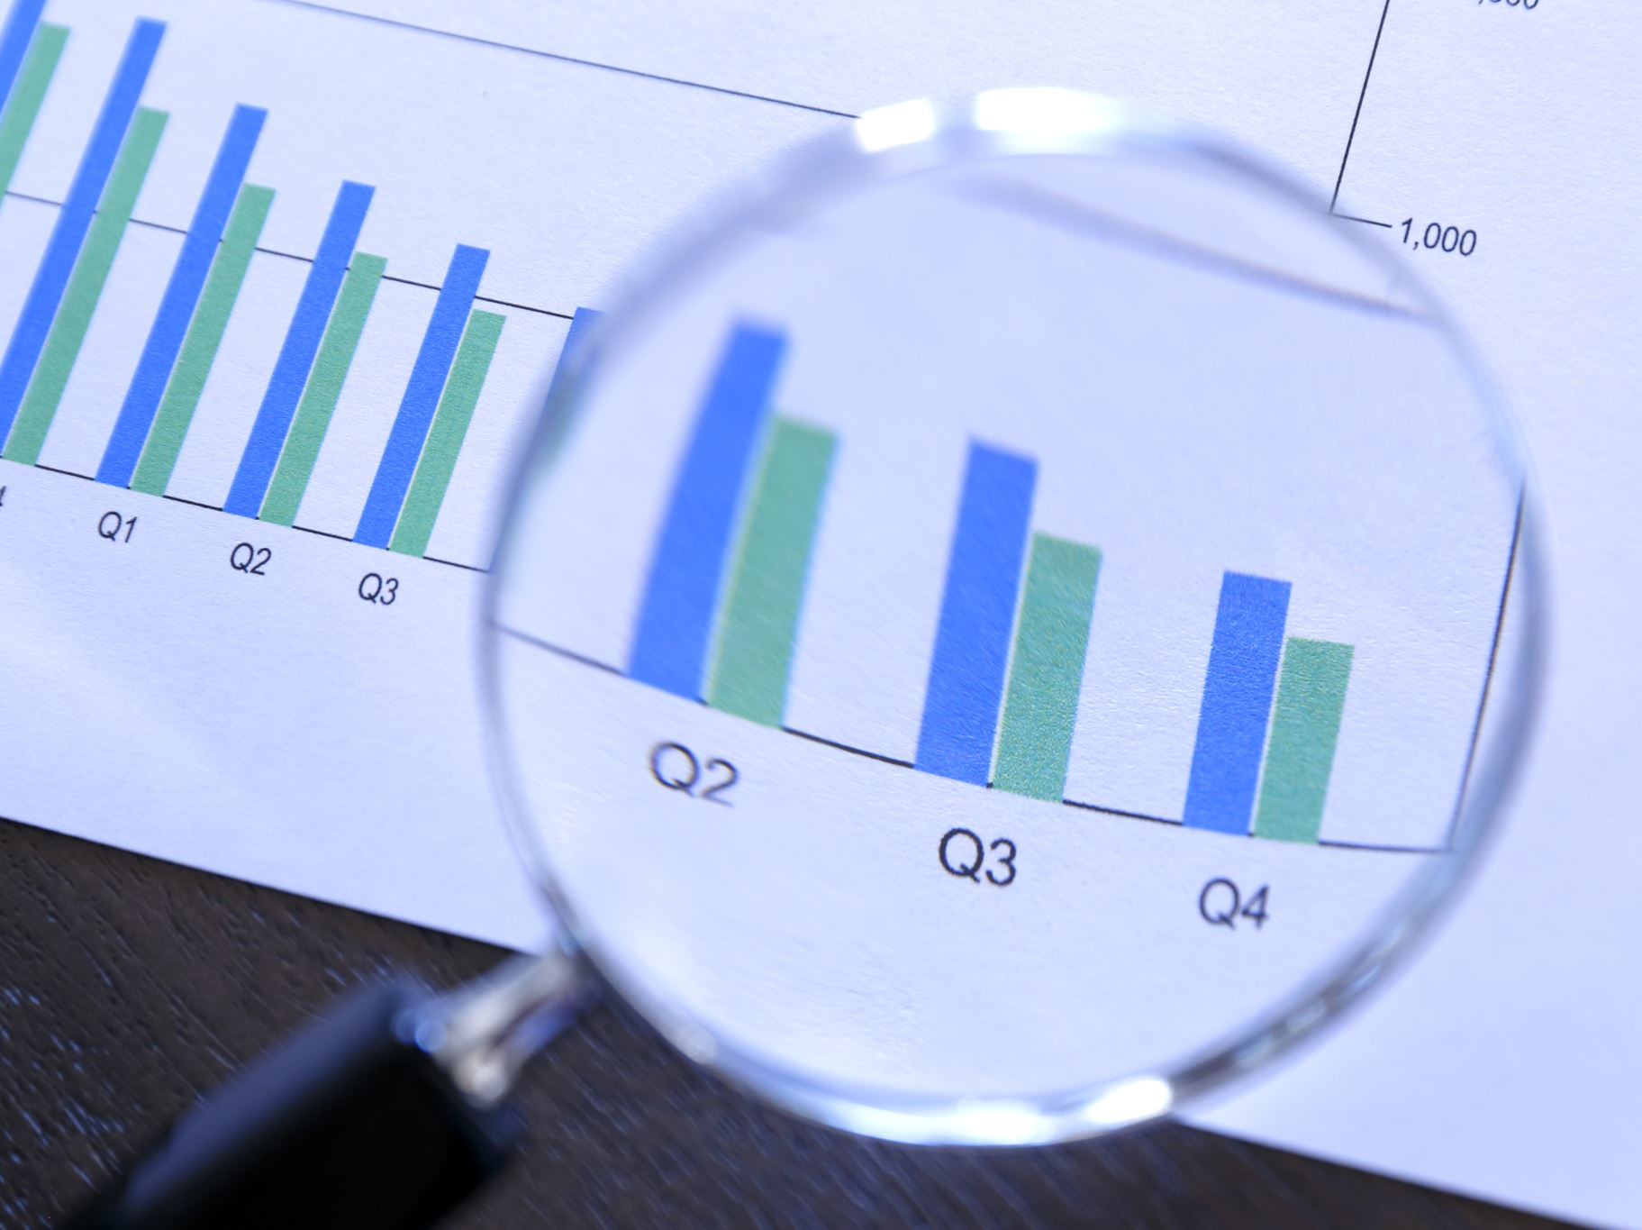
Contents
Introduction
Tools And Software Used
Problem Statement
Data Cleaning
Dashboard
Analysis with My SQL
Future Enhancement

Slide 3

Data Analysis
Data analysis refers to the process of examining, cleaning, transforming, and modeling data with the goal of discovering useful information, drawing conclusions, and supporting decision-making.
This Photo by Unknown Author is licensed under CC BY-NC-ND

Slide 4
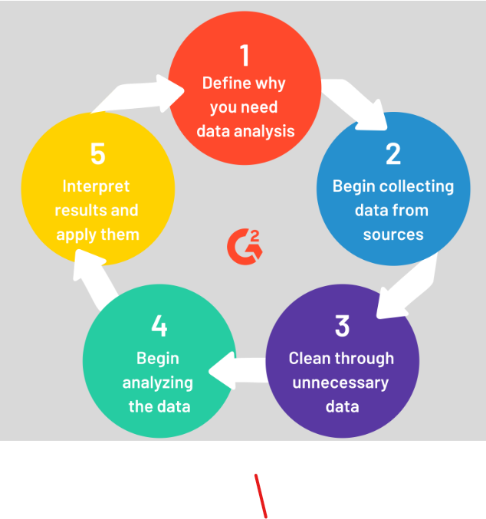
DATA ANALYSIS PROCESS
1. Define the problem: Clearly articulate what you are trying to solve or understand.
2. Collect and clean data: Gather relevant data, then preprocess and clean it for analysis.
3. Explore the data: Use statistical and visual techniques to understand data patterns and relationships.
4. Analyze the data: Apply statistical or machine learning methods to test hypotheses or make predictions.
5. Interpret and communicate results: Translate findings into actionable insights and effectively communicate them to stakeholders.

Slide 5

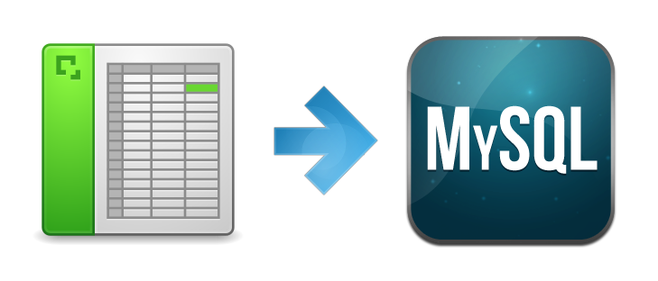
TOOLS
AND SOFTWARE
EXCEL
My sql

Slide 6
PROBLEM STATEMENT
1) What is the total sales for each month?
2) What is the total profit for each month?
3) How many orders were placed each month?
4) How have yearly sales evolved over the dataset period?
5) How have yearly profits changed over the same time?
6) Who are the top 5 customers based on total sales
7) Who are the top 5 customers based on profit?
8) Which product category yielded the highest sales?
9) Which product category was the most profitable?
10) Which sub-category was the most profitable?
11) Which state recorded the highest sales ?
12)Which specific products were the top 5 best-sellers ?

Slide 7
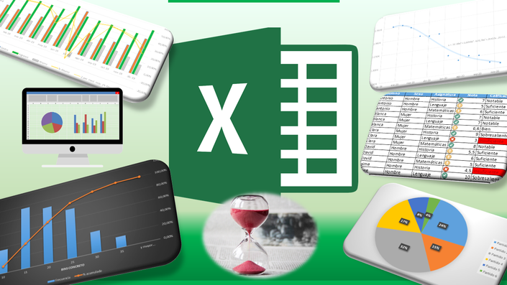
DATA CLEANING USING EXCEL
1. Remove Duplicates.
2. Fill Empty Cells Or Remove the row CONTAINING EMPTY CELL.
3. Correct Spelling Mistakes.
4. Convert Text to Numbers (or vice versa).
5. Standardize Data Casing (PROPER, UPPER, LOWER).
6. Use Find and Replace.
7. Apply Format Painter for consistent formatting.
8. Standardize Date Formatting.
9. Handle Error Cells with IFERROR.
10. Trim Extra Spaces using TRIM function.

Slide 8
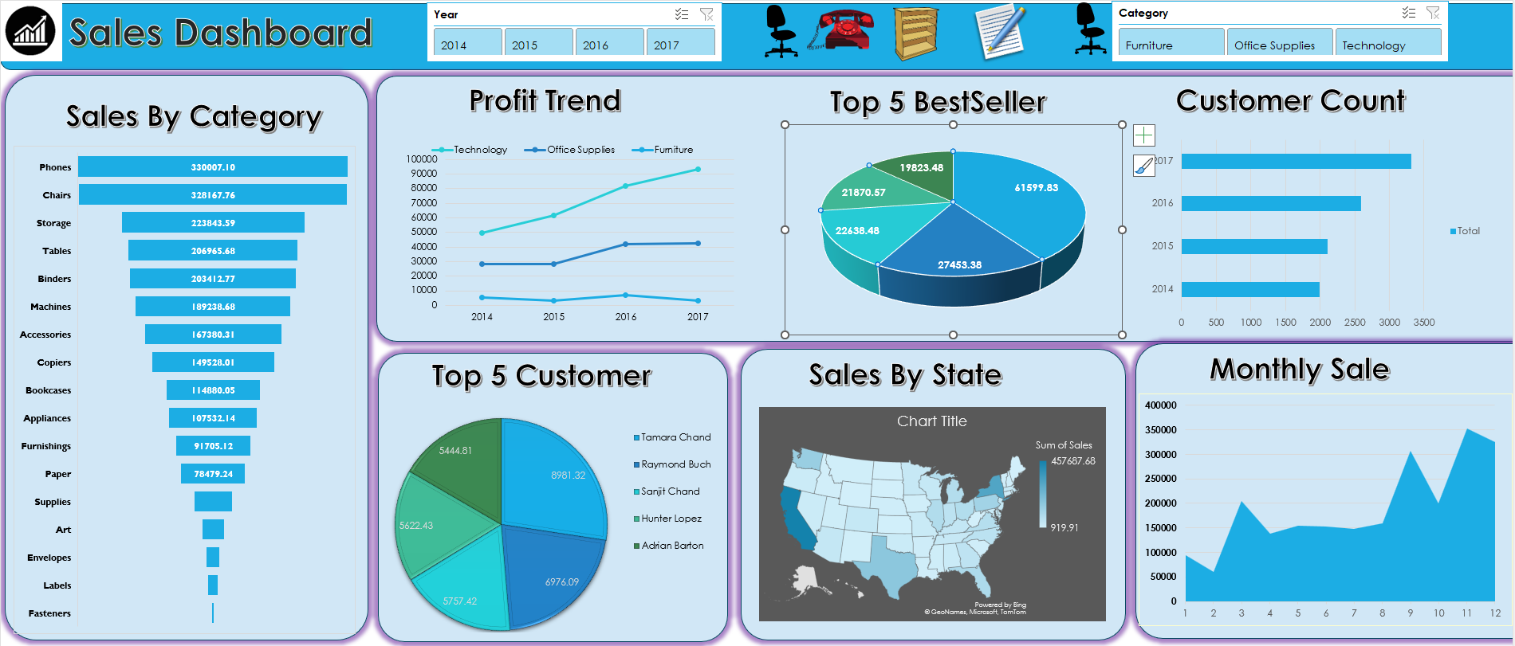
DASHBOARD USED FOR VISUALIZATION

Slide 9
ANALYSIS USING MYSQL
MySQL is an open-source relational database management system (RDBMS) that uses Structured Query Language (SQL) to manage and manipulate data stored in relational databases.
Now Question Arises How MySQL Is Used For Analysis:
Data Storage: MySQL provides a structured platform to store large volumes of data in tables, making it easier to organize and retrieve.
Data Retrieval: With SQL queries, analysts can easily extract specific data sets based on various criteria.
Aggregations: SQL provides functions (e.g., COUNT, SUM, AVG) that allow analysts to perform statistical calculations on the data.

Slide 10




1)No of rows and columns in the database
2) Top 5 Customer Based on Profit
Question on which I have worked on using Mysql.

Slide 11


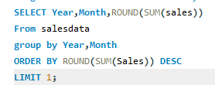
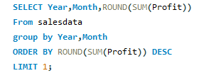


3) Monthly Sales
4)Yearly Sales
5) In which month and year did we observe the highest sales?
6)In which month and year did we observe the highest sales?

Slide 12
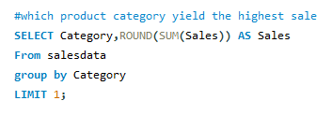
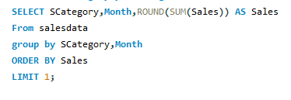
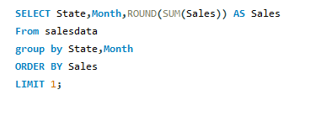
7)Which product category yields highest sales?
8)Which product Sub-category yields highest sales and in which month?
9)Which state recorded highest Sale and in which month?

Slide 13
FUTURE ENHANCEMENT
We can analysis the same data using python libraries.
Like Pandas,Numpy,Matplotlib etc
2) We can use most demanded Visvalization tools like Power bi,Tabulae.

Slide 14
THANK YOU

